Slide 1
UNIT-2
Role of Product Manager in Agile Development

Slide 2
Table of Content
Role of Product Manager in Agile Development.
Effective Communication and Conflict Resolution within Agile Teams.
Team-Based Exercises to Simulate Cross-Functional Collaboration.
Role-Playing Exercises for Agile Roles.

Slide 3
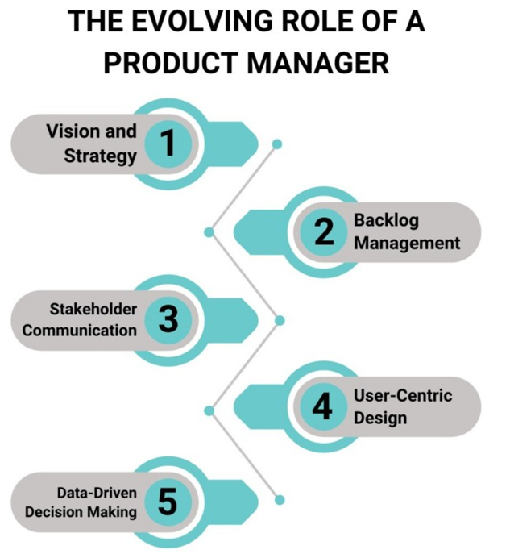
Role of Product Manager
The role of a Product Manager in Agile development is pivotal.
For aligning the team’s efforts with the organization's strategic goals while maximizing value delivery.

Slide 4
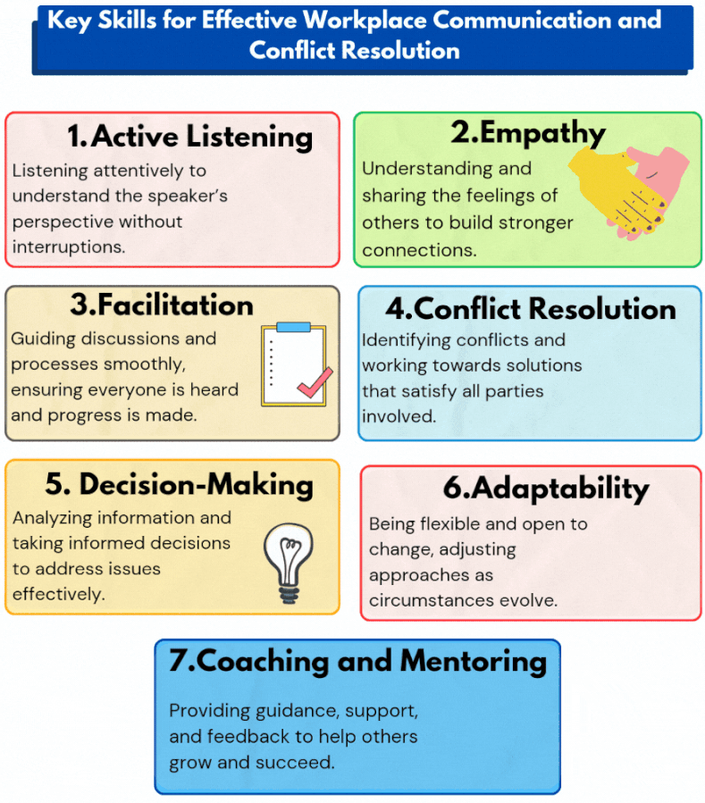
Effective Communication and Conflict Resolution within Agile Teams
1. Active Listening:
  Foster an environment where team members
  feel heard and valued.
2. Clear Expectations:
  Define roles, responsibilities, and workflows
  upfront to reduce confusion.
3.Conflict Resolution Techniques:
  Use root cause analysis to address the
  underlying issue, not just the symptoms.
4. Communication Practices:
Encourage daily stand-ups for transparency.

Slide 5
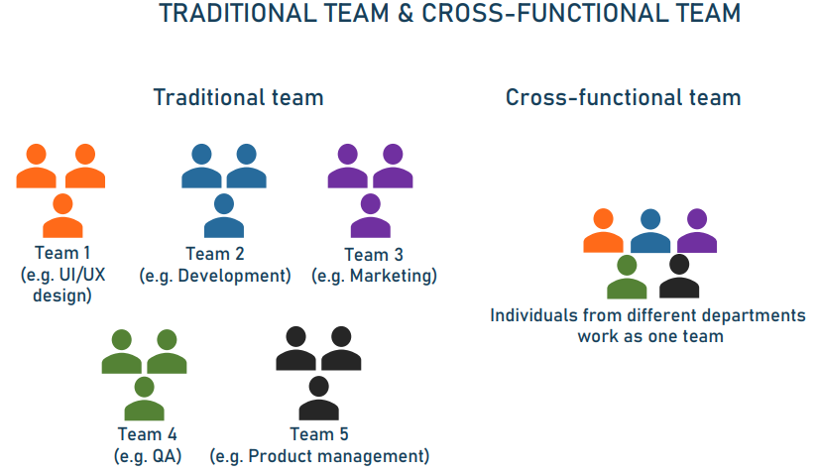
Team-Based Exercises to Simulate Cross-Functional Collaboration
1. Build a Paper Tower:
  Build the tallest, most stable paper tower
  using limited resources.
2.Customer Journey Mapping:
Map a user’s journey through a
hypothetical product.
3.Agile Lego Game:
  Create a product (e.g., a house or vehicle) in
  sprints using Lego bricks.

Slide 6
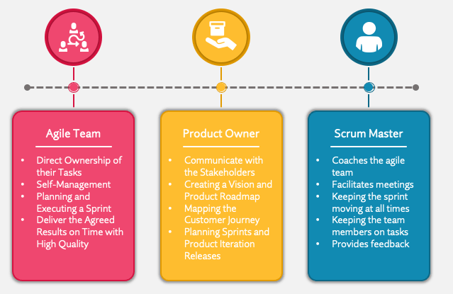
Role-Playing Exercises for Agile Roles
1. Product Owner Exercise:
Prioritize a product backlog with
conflicting stakeholder demands.
2. Scrum Master Exercise:
Facilitate a sprint retrospective
where team conflicts have arisen.
3. Team Member Collaboration:
Work as a cross-functional team to
solve a complex problem.

